Slide 1

Statistics
Variance, Standard Deviation, Percentile, Quartile, IQR, BoxPlot, Outliers

Slide 2
Measure of Dispersion
✅ What is Measure of Dispersion?
Measure of dispersion tells us how spread out or scattered the data values are around a central value (like mean or median).
While central tendency (mean, median, mode) tells us the center of the data, dispersion tells us about the variability.
📌 In data science, dispersion helps us understand how consistent or volatile the data is.
🎯 Why is Dispersion Important?
Identifies variability in the data
Helps compare consistency across datasets
Useful for risk analysis in business, finance, healthcare, etc.

Slide 3
Why is Dispersion Important?
✅ 1. Identifies Variability in the Data
🔹 What It Means:
Dispersion tells us how much the values in a dataset differ from the average or central value (mean/median).
🔹 Why It's Useful:
Two datasets can have the same mean but behave very differently. Dispersion highlights this variability.
🔹 Real-Life Example:
🎓 Student Test Scores:
Class A scores: 70, 72, 71, 69, 70
Class B scores: 50, 90, 40, 100, 70
Both may have a similar average (mean ≈ 70)
But Class A has low dispersion → students are consistent
Class B has high dispersion → performance varies widely
🧠 Insight: In education, dispersion helps identify whether teaching is equally effective for all students or only a few.

Slide 4
Why is Dispersion Important?
✅ 2. Helps Compare Consistency Across Datasets
🔹 What It Means:
Dispersion allows us to determine which dataset is more stable or reliable.
🔹 Why It's Useful:
In business and science, we often choose the option with less variability for predictability and control.
🔹 Real-Life Example:
🚚 Delivery Times of Two Couriers:
Courier X: Delivery times (in days): 2, 2, 3, 3, 2
Courier Y: Delivery times: 1, 5, 2, 6, 3
Mean delivery time may be same (≈ 2.5 days)
But Courier X has lower standard deviation → more consistent
Courier Y is unpredictable, sometimes fast, sometimes delayed
🧠 Insight: Businesses prefer suppliers with lower dispersion for consistent performance.

Slide 5
Why is Dispersion Important?
✅ 3. Useful for Risk Analysis in Business, Finance, Healthcare, etc.
🔹 What It Means:
Dispersion helps measure risk or uncertainty. Higher variability usually means greater risk.
🔹 Why It's Useful:
Organizations rely on dispersion to make informed decisions, manage risks, and allocate resources.
🔹 Real-Life Examples:
💼 Finance:
Two mutual funds have the same average return (10%), but:
Fund A: Std. Dev. = 2%
Fund B: Std. Dev. = 8%
Fund B is riskier due to higher volatility in returns.
🧠 Insight: Investors use standard deviation to assess risk.

Slide 6
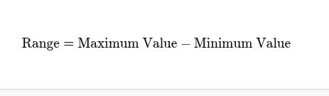
Range
Definition: The difference between the maximum and minimum values in the dataset.
Formula:
Example:
Set: 40, 50, 60, 70, 80
Range= 80 - 40 = 40

Slide 7


Variance
Definition:
Variance is a number that tells us how spread out the values in a data set are from the mean (average). It shows whether the numbers are close to the average or far away from it.
If the variance is small, it means most numbers are close to the mean. If the variance is large, it means the numbers are spread out more widely.
A higher variance indicates greater variability, meaning the data is spread, while a lower variance suggests the data points are closer to the mean.
Formula (Population): Formula (Sample):

Slide 8
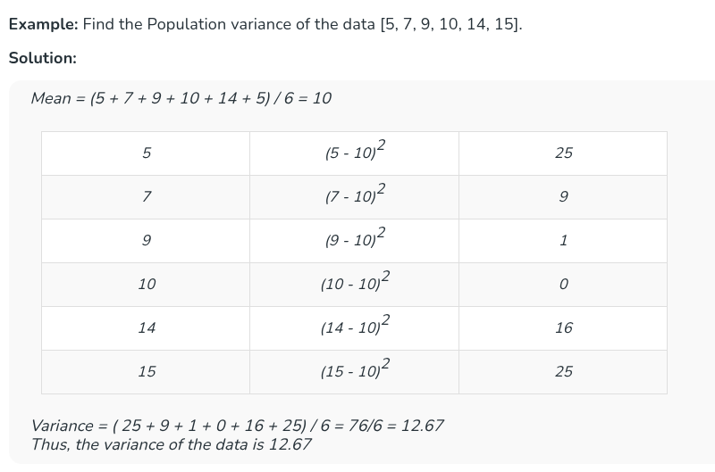
Variance

Slide 9
Variance
Example: Find the Sample variance of the data {4, 6, 8, 10}
Solution:
Mean = (4 + 6 + 8 + 10) / 4 = 7
Variance = (9 + 1 + 1 + 9) / (4-1) = 20/3 = 6.67
Thus, the variance of the data is 6.67
4 | (4 - 7)² | 9
6 | (6 - 7)² | 1
8 | (8 - 7)² | 1
10 | (10 - 7)² | 9

Slide 10

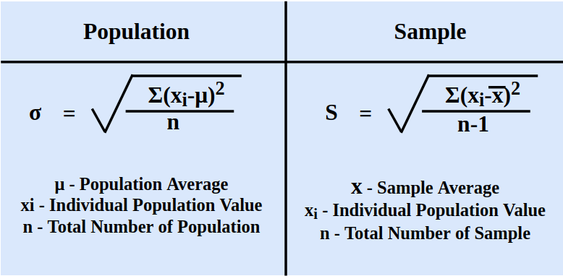
Standard Deviation
Definition: The square root of the variance. It tells how much the data deviates from the mean on average.
Formula:

Slide 11
Class Activities
Class Activity 1: Test Scores Analysis
Problem Statement:
The math test scores of 5 students are as follows:
Scores: 65, 70, 75, 80, 85
Tasks:
Calculate the Range of the scores.
Calculate the Mean of the scores.
Calculate the Variance (Sample variance).
Calculate the Standard Deviation (Sample standard deviation).

Slide 12
Class Activities
Class Activity 2: Delivery Time Comparison
Problem Statement:
A logistics company records delivery times (in hours) for two drivers over 6 deliveries:
Driver A: 2, 3, 3, 4, 3, 3
Driver B: 1, 2, 5, 6, 1, 3
Tasks:
For each driver, calculate:
Range
Mean
Variance (Sample)
Standard Deviation (Sample)

Slide 13
Percentile
✅ Definition:
A percentile is a statistical measure that indicates the value below which a given percentage of observations in a group of data falls. It helps understand how a particular value compares to the rest of the data.
In simple words, percentiles are a way to express the relative standing of a value within a dataset, indicating what percentage of the data falls below that value.
For example, if you scored in the 90th percentile on a standardized test, it means you performed better than 90% of the people who took the test.

Slide 14
Percentile
To find the value corresponding to a specific percentile, the following formula is used:
Percentile(x) = (Number of values fall under 'x'/total number of values) × 100 P = (n/N) × 100
Where,
P is the percentile,
n - Number of values below 'x',
N - Total count of population.
Note: First we need to sort the data/population before starting the process.

Slide 15
Percentile
Question 1: What is the percentile value for the score 80 for the given population: 50, 100, 70, 80, 56, 60, 80, 75?
Solution:
The given data is not sorted. So first sort the data in ascending order.
Sorted data: 50, 56, 60, 70, 75, 80, 80, 100
Number of values fall under 80 (n) = 5
Total count of values (N) = 8 Percentile = (n/N) × 100 = (5/8) × 100 = 62.5
The percentile of value 80 for the given population is 62.5

Slide 16
Percentile
How to Calculate Percentile
Arrange n number of data points in ascending order: x1, x2, x3, ... xn
Calculate the rank r for the percentile p you want to find: r = (p/100) * (n - 1) + 1
If r is an integer then the data value at location r, x_{r}, is the percentile p: p = x_{r}
If r is not an integer, p is interpolated using ri, the integer part of r, and rf, the fractional part of r: p = x_{ri} + rf * (x_{ri+1} - x_{ri})

Slide 17
Percentile
Question 3: What is the 15th percentile for the given population of weights of persons 50, 55, 40, 60, 100, 95, 90, 60, 80, 75?
Solution:
The given data is not sorted. So first sort the data in ascending order.
Sorted data: 40, 50, 55, 60, 60, 75, 80, 90, 95, 100
r = (p/100) * (n - 1) + 1
= (15/100) * (10 - 1) + 1
= 0.15 * 9 + 1
= 2.35
As the r is not integer,
p = x_{ri} + rf * (x_{ri+1} - x_{ri})
= 50 + .35 *(55 - 50)
= 51.75

Slide 18
Class Activities
Question 1: What is the percentile value for the score 95 for the given population: 50, 55, 40, 60, 100, 95, 90, 60, 80, 75?
Question 2: Determine the 90th percentile for the dataset below: {3, 7, 10, 15, 20, 25, 30, 35, 40, 45, 50}.

Slide 19
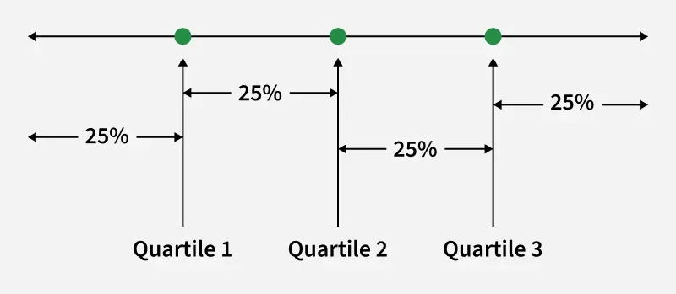
Quartile
Quartiles divide a data set into four equal parts, each containing 25% of the data. They help to understand the spread and center of the data. As an important concept in statistics, quartiles are used to analyze large data sets by highlighting values near the middle. This method is particularly useful for identifying outliers and comparing different data sets.
There are three quartiles:

Slide 20
Quartile
Lower or First Quartile (Q1)
Quartile 1 lies between the starting term and the middle term.
This is the median of the lower half of the data set.
It is also known as the 25th percentile because it marks the point where 25% of the data is below it.
Median or Second Quartile (Q2)
Quartile 2 lies between the starting terms and the last terms, i.e., the Middle term.
This is the median of the entire data set.
It is also known as the 50th percentile, as it divides the data into two halves.
Upper or Third Quartile
Quartile 3 lies between quartile 2 and the last term.
This is the median of the upper half of the data set.
It is also known as the 75th percentile because it marks the point where 75% of the data is below it.

Slide 21
Quartile
For Example: Find the Q1, Q2, and Q3 of the given dataset: 3, 5, 7, 8, 10, 11, 3, 1, 1, 11.
Solution:
Arrange the dataset in ascending or descending order, depending on your preference. We will arrange the data in ascending order: 1, 3, 3, 5, 7, 8, 10, 11, 11
1st Quartile(Q1) = 25th Percentile = 3
2nd Quartile(Q2) = 50th Percentile = 7
3rd Quartile(Q3) = 75th Percentile = 10

Slide 22
Interquartile Range(IQR)
Interquartile Range
Interquartile Range is the distance between the first quartile and the third quartile. It is also known as a mid-spread. It helps us to calculate variation for the data, which is divided into quartiles. The formula for calculating the Interquartile range is given by,
Interquartile Range (IQR) = Q3 - Q1
Where,
Q3 is the third/upper quartile, and
Q1 is the first/lower quartile.

Slide 23
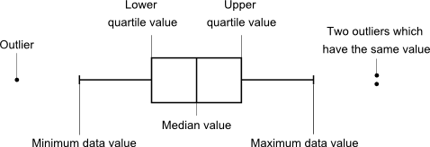
Box Plot (Box-and-Whisker Plot)
A box plot, also known as a box-and-whisker plot, is a graphical representation of data that summarizes the five-number summary: minimum, first quartile (Q1), median (Q2), third quartile (Q3), and maximum. It visually displays the central tendency, spread, and potential outliers of a dataset. The shape of the boxplot shows how the data is distributed and it also shows any outliers.

Slide 24
Box Plot (Box-and-Whisker Plot)
Mathematical Example: Let's consider a dataset: 1, 2, 3, 4, 5, 6, 7, 8, 9, 10
1. Five-Number Summary:
Minimum = 1
Q1 = 3
Median = (5 + 6) / 2 = 5.5
Q3 = 8
Maximum = 10
2. Find IQR, Lower Extreme and Upper Extreme
IQR =(Q3 -Q1) = 8 - 3 = 5
LE = Q1 - 1.5 x IQR = 3 - 1.5 x 5 = -4.5
RE = Q3 + 1.5 x IQR = 8 + 1.5 x 5 = 15.5

Slide 25
Class Activities
Exam Scores Analysis
Problem Statement:
The following are the exam scores of 11 students in a math test:
42, 50, 51, 55, 59, 60, 64, 67, 70, 75, 78
Tasks:
Find Q1 and Q3.
Calculate the Interquartile Range (IQR).
Determine if there are any outliers using 1.5 × IQR rule.
Draw a Box Plot

Slide 26
Thank You

